Slide 1
Clustering Market Regimes
Final Project
William Barnett, Preston Smith

Slide 2
Project Review
Idea Recap
Investigate distinct market regimes distinguishing market behaviors with clustering
Datasets
SPY - Large Stocks (S&P 500)
IWM - Small Stocks (Russell 2000)
QQQ - Tech Stocks
TLT - Treasury Bonds
Scope
Capture and compare each model’s output against known regimes.
Models
KMeans
GMM
HDBSCAN
Notes:
Aa a recap of our project, the core idea is to investigate distinct market regimes, the different behavioral states that financial markets move through over time. These are often known as bull markets, bear markets, and high volatility periods. Rather than identifying these manually, we're using clustering algorithms to detect them automatically, with the specific scope to capture and compare multiple models across different kinds of datasets against known market regimes such as the Covid-19 crash, and the 2022 bear market.
For our data, we're pulling from four sets that give different insights ito specific pieces of the market. SPY tracks the S&P 500, so it represents the broad stock market. IWM tracks the Russell 2000, which covers small-cap stocks, smaller, more volatile companies that tend to react more to economic shifts than the SPY. QQQ focuses on tech-heavy stocks like Apple, Microsoft, and Nvidia. And TLT represents long-term treasury bonds, which tend to rise when investors flee stocks, making it a good safe haven signal. We did also end up expanding to
For our models, we're running three clustering methods. K-Means, GMM, and DBSCAN to get different methods of regime detection.

Slide 3
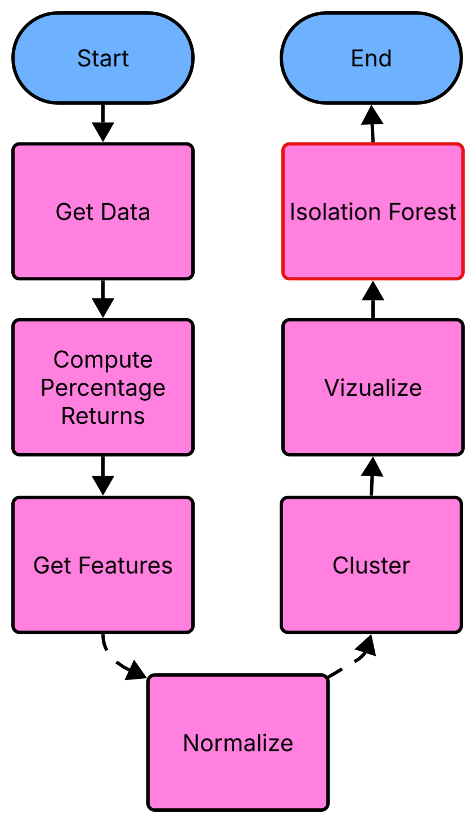
Implementation Update
What was already implemented
Preprocessing for each model
Basic KMeans, GMM, and HDBSCAN models
Some visualization
  Not intuitively insightful
What's new
Refined, standardized Pipeline
More insightful visualizations
Bonus: Isolation Forest
Notes:
Before getting into the results, here's a quick look at what we built and what changed since our last update.
The flowchart on the left shows our full pipeline. We start by pulling daily price data for our four chosen datasets, compute percentage returns to capture day-to-day movement, engineer the features such as volatility, dispersion, correlation, and so on. And then normalize everything before feeding it into the clustering models. Each model produces regime labels, which we visualize, and then Isolation Forest runs on the same preprocessed data as our bonus step.
In terms of progress, we already had basic versions of KMeans, GMM, and HDBSCAN running with preprocessing in place, but the visualizations weren't telling us much, iit was hard to see what each regime actually meant and we had way to big of a time period that we wanted to investigate.
What's new is that we refined the whole pipeline into a single standardized flow, so all three models share the same preprocessing and feature set, which makes the comparison fair. We also rebuilt the visualizations to actually show regime behavior over time, for this presentation we focused on the 2020 COVID crash and . And finally, we added Isolation Forest as a bonus to validate our clustering results with a completely independent method.

Slide 4
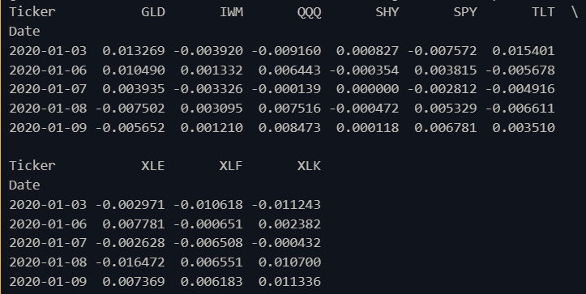
Data & Preprocessing
Ticker Return Prices
Gathered from daily stock prices
Transformed to represent movement
Dropped na
Notes:
Daily Stock Prices -> Moving return changes
SPY – Tracks the S&P 500 (large U.S. companies; overall market)
QQQ – Tracks the Nasdaq-100 (tech-heavy growth stocks)
IWM – Tracks the Russell 2000 (small-cap companies; more sensitive to economic changes)
TLT – Tracks long-term U.S. Treasury bonds (safe-haven asset; rises during market stress)
SHY – Tracks short-term U.S. Treasury bonds (very low risk; similar to cash)
GLD – Tracks gold prices (inflation hedge and crisis asset)
XLE – Tracks the energy sector (oil & gas companies; sensitive to inflation and commodities)
XLF – Tracks the financial sector (banks and insurers; sensitive to interest rates)
XLK – Tracks the technology sector (growth and innovation companies)

Slide 5
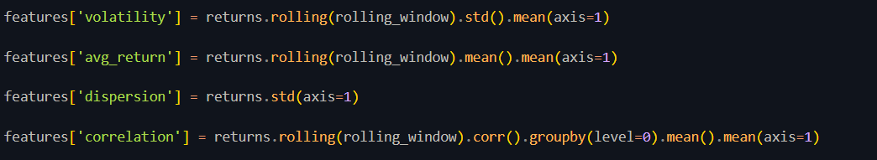
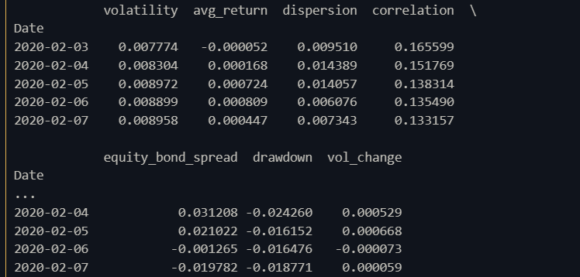
Data & Preprocessing
Desired Features
Volatility
Average Return
Dispersion
Correlation
Equity Bond Spread
Drawdown
Volume Change
Notes:
Descriptions
================
Volatility: How much are prices jumping around
Average Return : Is the market going up or down?
Dispersion: Are assets moving differently from each other?
Correlation: Are assets moving differently from each other?
Equity Bond Spread: Are investors favoring risk (stocks) or safety (bonds)?
Drawdown: How far are we below recent highs?
Volume Change: Is risk increasing or decreasing?

Slide 6
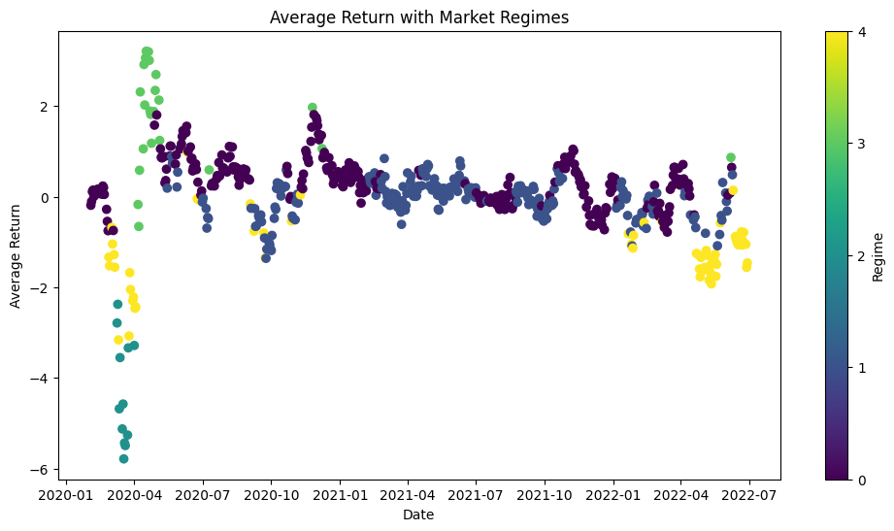
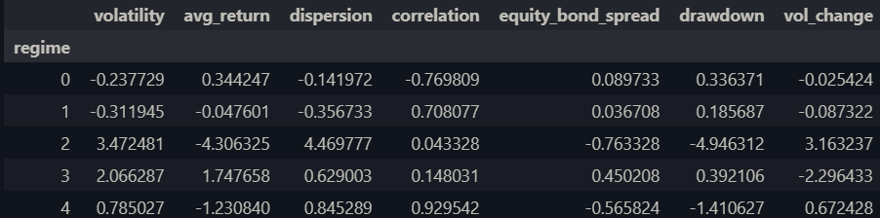
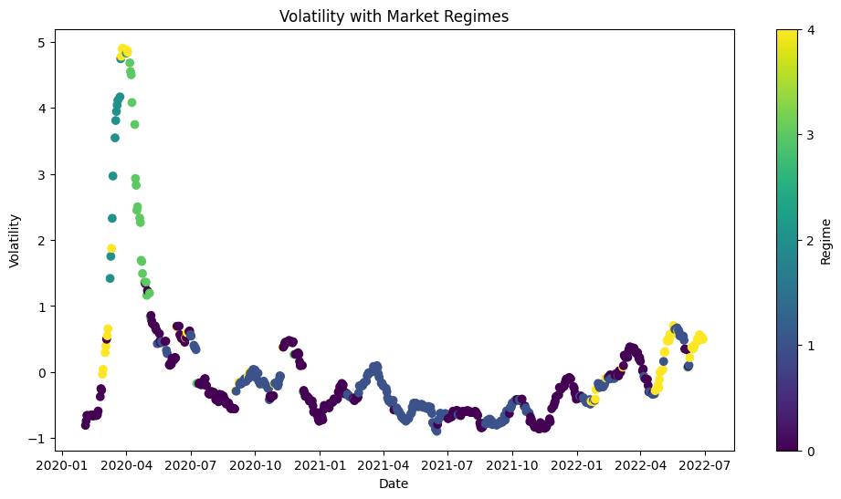
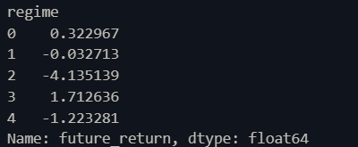
Experimental Results
K Means
Notes:
KMeans partitions the data into a fixed number of regimes.
Regime 3 shows a strong bullish (positive growth) pattern
Regime 2 shows massive Crisis pattern in growth
Other regimes show smaller patterns of growth such as bear, stagnant, etc
Explain graphs for avg return trends with regimes and how volatile they are
Overall K means is able to segment meaningful regimes however creates smaller similar trends as well which can be observed on the market however due to its nature it can be very susceptible to noise.

Slide 7
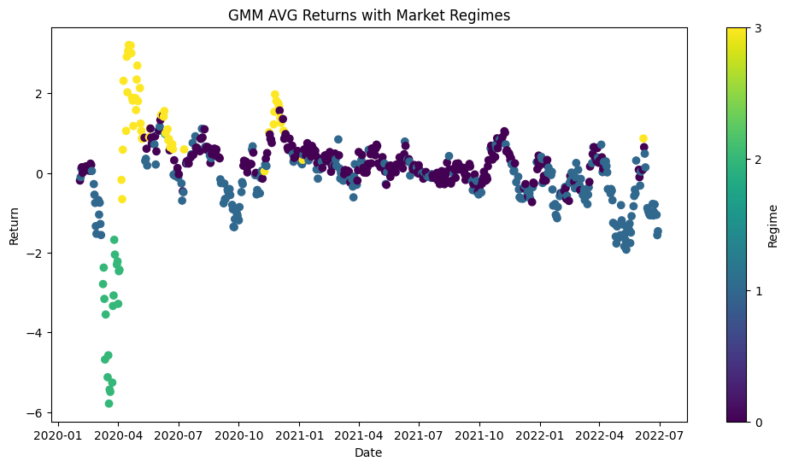
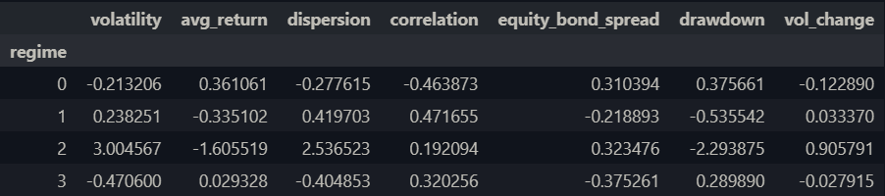
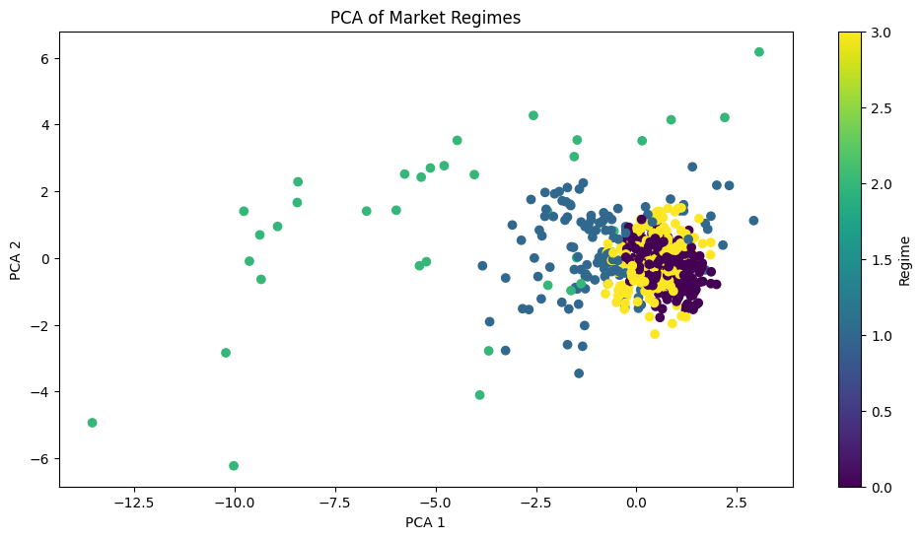
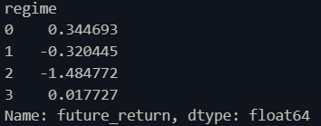
Experimental Results
GMM
Notes:
GMM models regimes probabilistically, allowing for overlap between states rather than forcing hard boundaries.
Clear regimes without extremes as can be seen positive return in regime 0, negative (bear) with regime 1, and crisis markets in regime 2
PCA plot shows one main cluster along with one major seperated region within, capturing the underlying structure more realistically, with smoother transitions between regimes.
Unlike Kmeans, GMM is able to more accurately represent the continuous nature of the stock market

Slide 8
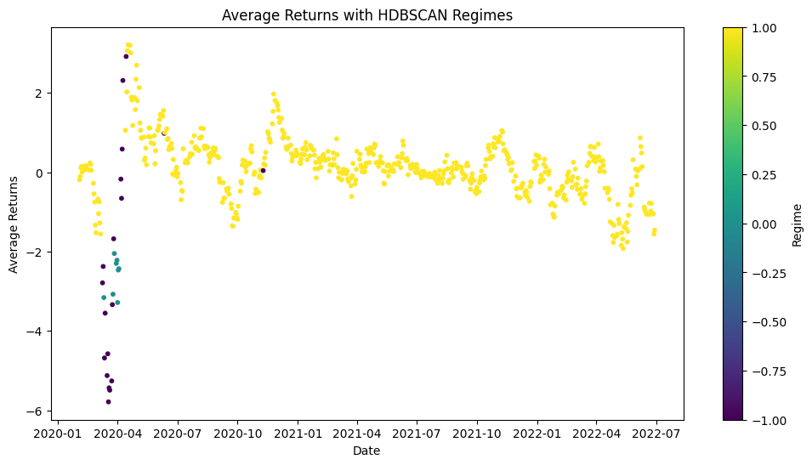
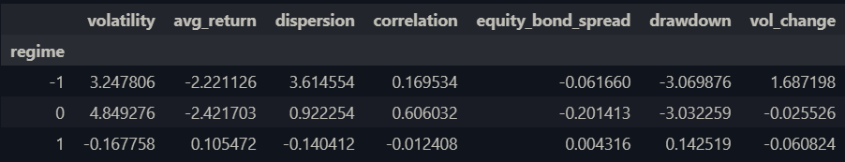
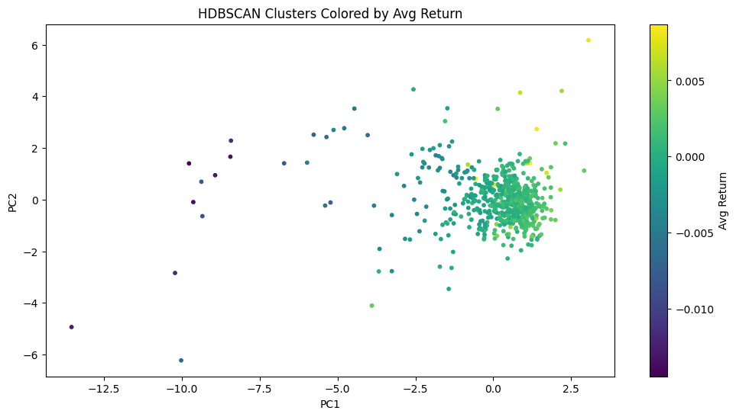

Experimental Results
HDBSCAN
Notes:
HDBSCAN identifies clusters based on density and automatically detects noise or outliers.
Unlike the prior two models shown the clusters captured represent normal market beahvior compared to massive changes during crisis and stress. Additionally highlighting the bubble nature of the stock market.
Overall, HDBSCAN highlights that most market behavior is continuous, with only a few distinct extreme regimes. Where captured noise is registered as extreme negative changes within the strock market such as the 2020 crash.
To sum it up compared to the other two, HDBSCAN suggests the market primarily operates in one regime, with occasional shocks.

Slide 9
Experimental Results
Takeaways
All identified
  A normal regime
  A negative/risk-off regime
  An extreme crisis regime
Regimes are tangible and not tied to models
GMM most effective model
Notes:
The consistency across methods validates the feature engineering and suggests that these regimes are real, not artifacts of a specific model.
GMM provides the most balanced representation, capturing both regime structure and smooth transitions.
These results suggest that regime-based models can be used to adapt investment strategies dynamically based on market conditions.

Slide 10
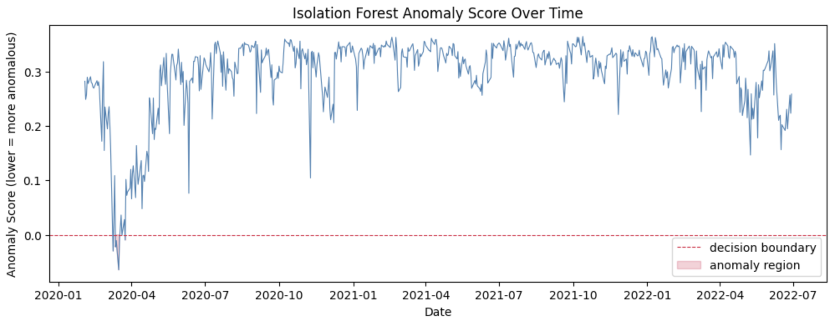
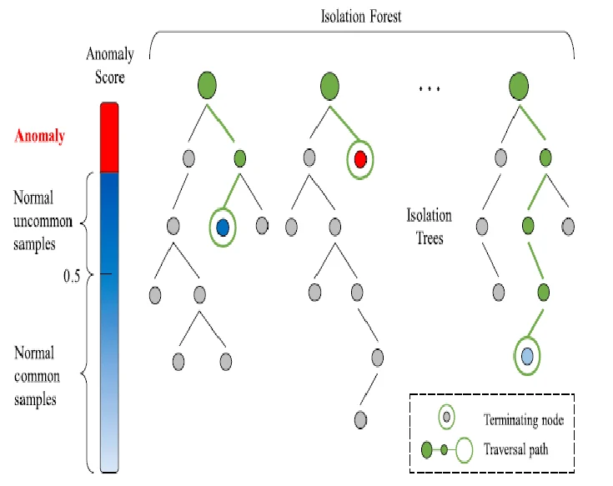
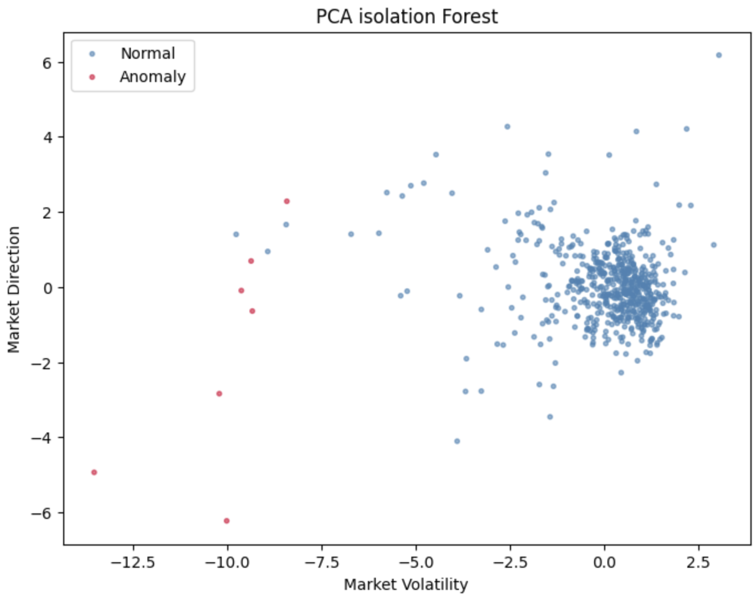
Bonus: Isolation Forest
Original Scope
Find and compare market regimes using unsupervised machine learning
  Originally just planned for k means
Isolation Forest
Find outliers in the data overall
  Overall data, not in clusters
Validates clustering results
  In this example 2020 COVID crash
Notes:
The original scope of our project dealt with simple market detection, specifically wanting to just use kmeans as the method used to detect these regions. After the overview presentation, we received the feedback to include multiple methods and compare them against eachother, with a recommendation to look into isolation forests, but not required for our project, so for our bonus implementation, we added Isolation Forest, which approaches the problem differently from our clustering models. Instead of grouping points by distance or density, it builds random decision trees and measures how quickly each point gets isolated. Anomalies end up alone after just a few random splits, while normal points take many more. The shorter the average path length, the more anomalous the point.
You can see the result in the top graph. The score plunges below the decision boundary only in March and April of 2020, showing the extremely high volatility of the COVID crash. What these anomalous regions really represent are periods of extreme market instability, the moments where the biggest, most violent changes in the stock market actually happen. You can see it too in the PCA scatter, where the red anomaly points sit far from the dense mass of normal trading days, better showing the distribution of trading days, specifically detailing the points that the model picked out as anomalies, with the direction and volatility at those times. These are the days that don't behave like normal trading days, and have the biggest impacts on the market, giving us more insight into the market behaviors at certain periods in time.

Slide 11
Github
Github page: https://will-78.github.io/Market-Regime-Detection
Github Repository:
https://github.com/Will-78/Market-Regime-Detection

Slide 12
THANK YOU!

